Slide 1
Instruct 4D-to-4D (CVPR2024)
Instruct 4D-to-4D: Instruction-Guided 4D Scene Editing
Instruction
IP2P (2D):
Original Image
Edited Image
Instruction
IN2N (3D):
Static NeRF Scene
Edited Static NeRF
Instruction
Ours (4D):
Dynamic NeRF Scene
Edited Dynamic NeRF

Slide 2
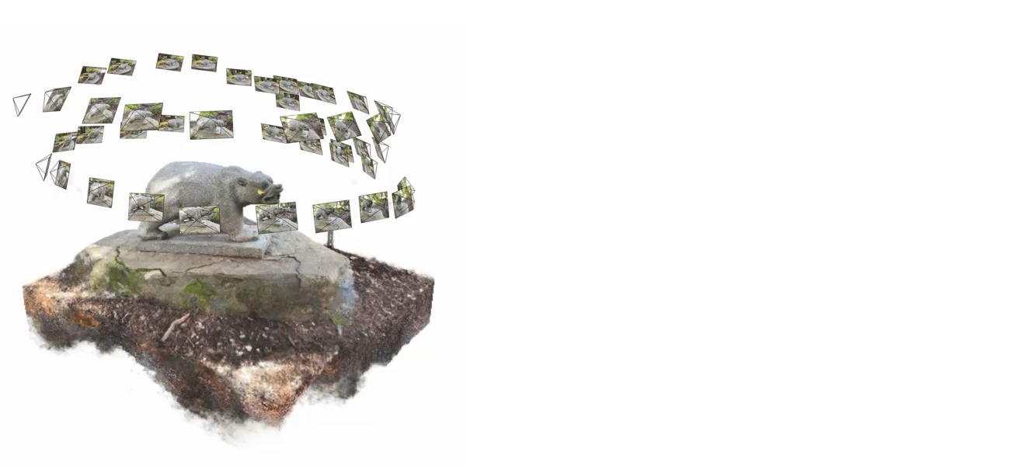
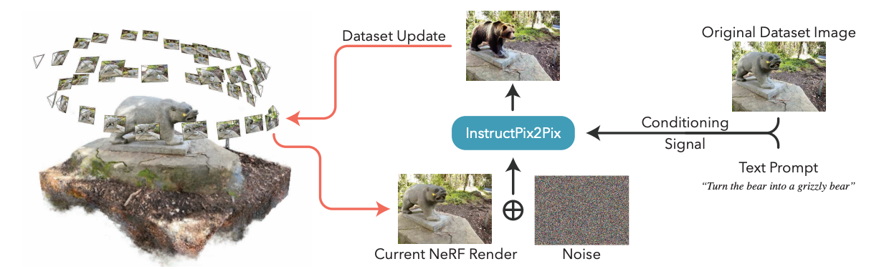

Related Works (Instruct-NeRF2NeRF)
IN2N gradually updates a reconstructed NeRF scene by iteratively updating the dataset images while training the NeRF:
An image is rendered from the scene at a training viewpoint.
It is edited by InstructPix2Pix given a global text instruction.
The training dataset image is replaced with the edited image.
The NeRF continues training as usual.
Instruct-NeRF2NeRF: Editing 3D Scenes with Instructions, ICCV2023

Slide 3
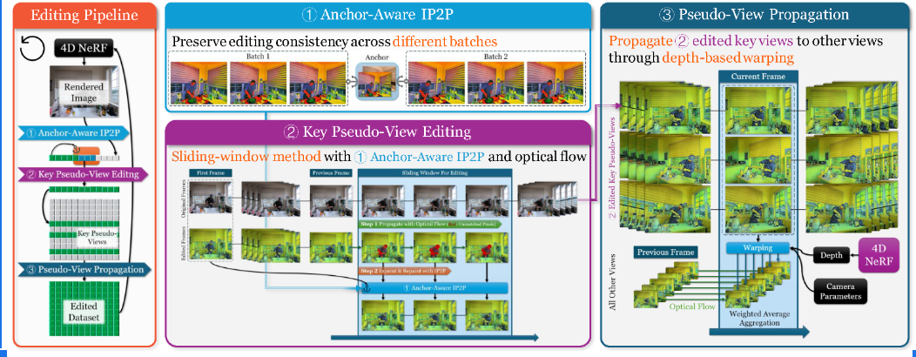
Our Idea and Motivation
Key idea: Instruct 4D-to-4D edits 4D scenes as pseudo-3D scenes, by iteratively distilling the editing signal from 2D diffusion models
1. Temporal consistency in single pseudo-view (single-view videos)
2. Spatial consistency across pseudo-views (multi-view videos)

Slide 4
Our Pipeline
1. Key Pseudo-View Editing –Flow-Guided Temporal Warping
2. Pseudo-View Propagation -- Depth-Guided Spatial Warping

Slide 5
Key Pseudo-View Editing
Step1: Edit the keyframe
Step2: Propagate the previous frame appearance to the frames in the current window using optical flow tracking
Step3: With the keyframe as the anchor, use fine-tune anchor-aware IP2P to jointly inpaint the occluded part of frames in the current window
Step4: Repeat the Step 2 and 3 until matching the end

Slide 6
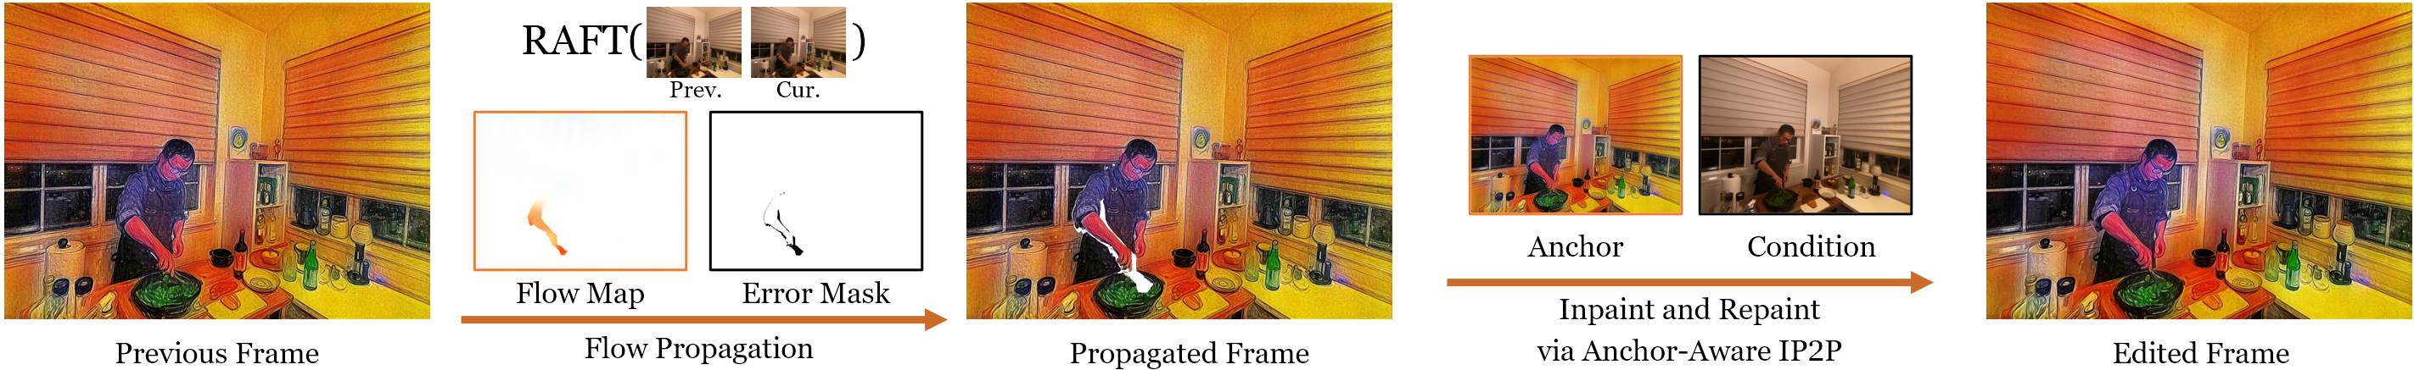
Flow-Guided Temporal Warping
Step2: Propagate the previous frame appearance to the frames in the current window using optical flow tracking
Step3: With the keyframe as the anchor and the original image as the condition, use anchor-aware IP2P to jointly inpaint and repaint the propagated frame in the current window

Slide 7
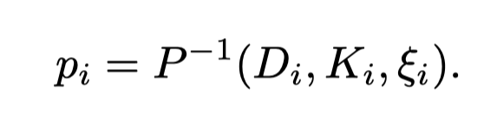
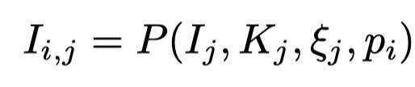
Depth-Guided Spatial Warping
Given that depth information can be obtained from NeRF for free, we leverage it as guidance to establish image correspondences between different views and then project edited pixels in the edited image to the corresponding pixels in other views, thereby enhancing consistency.
the 3D point cloud associated with view i
the corresponding pixels on view j
Notes:
NeRF models are capable of generating depth maps directly, thereby making it possible to construct geometric relationships between different views.

Slide 8
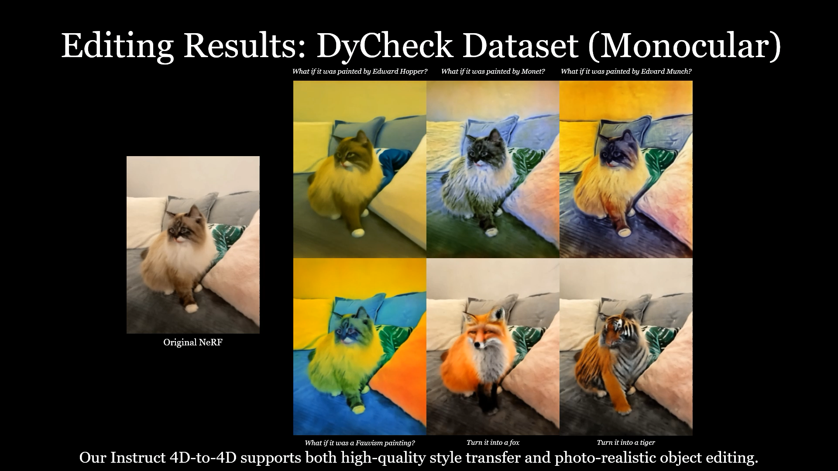
Some Results ( [30x] faster than baseline; [+4] CLIP Score than baseline )
Notes:
Our Instruct 4D-to-4D achieves high-quality, high-fidelity editing results in both monocular and multi-camera 4D scenes across various tasks

